Slide 1
PLEASE NOTE:
Although you may not make changes to this Google Slide Presentation, you may replicate a version so that you can edit to adapt to the needs and available technologies for your setting.
If your gmail account is open, you can click on File and MAKE A COPY to save it in Google Slides format. Once you make a copy, you may present offline. See the following link for directions: Work on Google Docs, Sheets, & Slides offline - Computer - Docs Editors Help. You can also click on File and choose DOWNLOAD, allowing the Google Slides version to be converted to a PowerPoint version. (Once you have downloaded and saved your copy, you may delete this first slide so it does not appear in your presentation.) You may also publish your slides to the web once you have made a copy and modified as you like. From the web, presenters do not need to use Google Slides. Directions found here: https://support.google.com/a/users/answer/9308870?hl=en
The presentation works best when opened in Chrome.
Those using Google Slides should be certain to use “Presenter View” (under the “Present” button) in order to see all layers of the slides. Those using PowerPoint should be certain to use “Presenter View” (under the “Slide Show” tab) in order to see all layers of the slides. Additional “Notes” are offered for many of the individual slides offering information or ideas for presenting the slide. These should be read before (and during, as needed) the presentation. In both Google Slides and PowerPoint, the “Notes” are found under the slides in standard view and are also visible in “Presenter View.”
It is recommended that you review the 6-8 Lesson Plan for additional background material and ideas. This is available in the Shared Drives>Protection of Children>Safe Environment Training for Children Materials folder or by using this link: https://docs.google.com/document/d/1y9n4OD15wbY6OBpWHCP539YRgDNzyNkyuNCambVX5hM/edit?usp=sharing

Slide 2
Notes:
REMINDER: Please be certain you are using the Presenter View!

Slide 3
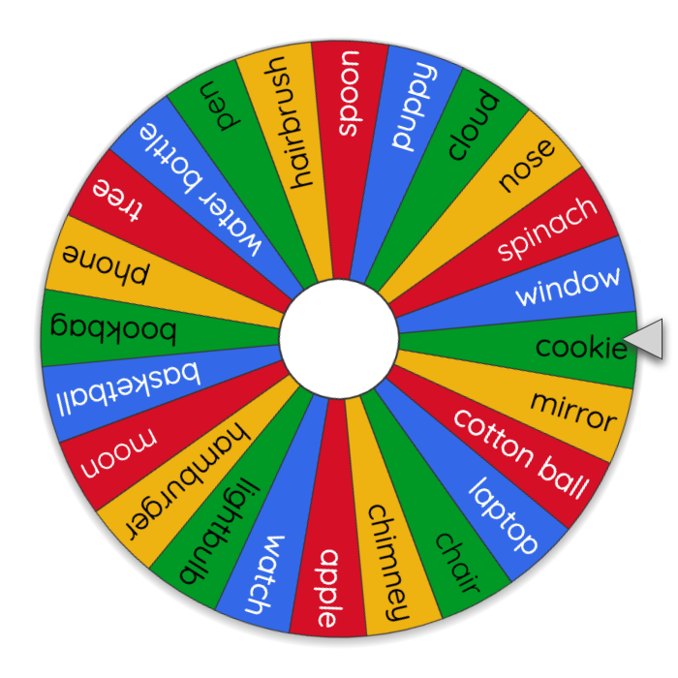
A _?_ Is Like A Faithful Friend
Click on the wheel to spin. When it lands, name one way that the object selected is like a faithful friend. Example: A cookie is like a faithful friend because it can be filled with fun surprises like M&Ms and chocolate chips!
Notes:
PLEASE NOTE: Clicking on the spinner causes a new tab to open in your browser. It may not be seen by your viewers if you are sharing the slides virtually -- or it may interrupt your presentation. If you are not comfortable with that technology in your setting, you may skip to an alternate activity on the next slide.

Slide 4
A _?_ Is Like A Faithful Friend
When the time begins, you’ll have 30 seconds to grab an inanimate object and be ready to explain how that object is like a faithful friend. Example: Grab a cookie and explain that it is like a faithful friend because it can be filled with fun surprises like M&Ms and chocolate chips!
Notes:
PLEASE NOTE: Skip this slide if you completed the previous one.
If you do not see the PLAY ARROW on the time image, clicking on the timer image may causes a new tab to open in your browser. It may not be seen by your viewers if you are sharing the slides virtually -- or it may interrupt your presentation. If you are not comfortable with that technology in your setting, you may simply offer a verbal countdown without using the video time.

Slide 5
Let’s see what the bible says
about friends.
Faithful friends are a sturdy shelter;
Whoever finds one finds a treasure.
Faithful friends are beyond price,
No amount can balance their worth.
Faithful friends are life-saving medicine;
Those who fear God will find them.
Sirach 6:14-16
Which description of a friend do you prefer:
1. Sturdy shelter 2. Treasure 3. Something beyond price 4. Life-saving medicine
Notes:
Invite students to share their responses and explain why they chose them.
Or you might ask all who prefer #1 to raise their hands, and then call upon one or two to explain why they chose that answer. REPEAT with responses 2-4.

Slide 6
Our
model
for faithful
friendship is
The Holy Trinity!
Did you know….?
The Trinity is a relationship (friendship) between three Persons: Father, Son, and Holy Spirit.
The Father is faithful to the Son, and the Son is faithful to the Father,
and the Holy Spirit is the love that proceeds from that faithful friendship.
God made us in his image and likeness.
God lives in faithful relationship.
Therefore we, in his image and likeness, are called to live in faithful relationship with others.
To have faithful friends, and to be a faithful friend... is to be HOLY!

Slide 7
Let’s see what the bible says about why we should be a faithful friend.
Do you not know that your body is a temple of the Holy Spirit within you…? 1 Corinthians 6:19
Therefore… when we are a faithful friend to another person,
we are being a faithful friend to God who dwells within each person.
Each person is a living temple for God.
Amen, I say to you, whatever you did for one of these least brothers of mine, you did for me. Matthew 25:40
Therefore… when we care for another by being a faithful friend,
we are caring for Jesus and being a faithful friend to him.
Notes:
Make sure students understand that how we treat others is how we treat God.
Similarly, how others treat us is also their treatment of God.

Slide 8
Is a person a faithful or an unfaithful friend to you if he/she pressures you to...
FAITHFUL?? or UNFAITHFUL??
Go to a movie with a high school junior who asked you
Give up your childhood blanket when you go to sleepovers with your friends
Drive past McDonald's and choose healthier food instead
Wear deodorant
Not share photos or meet alone
with someone online who you haven’t met in person
Look at pornography
Warns you not to tell anyone about something you know is wrong
or that makes you feel uncomfortable
Go to a party without adults present
Let your younger sibling tag along to the playground with you
Try some beer with your peers
Treat your catechist with kindness and respect
Study for the test coming up tomorrow
Attend the parish youth night activity
“Get physical” (more than a simple hug or kiss) with your boyfriend/girlfriend
Cheer for the Green Bay Packers
Use social media to smear a peer who turned another friend against you
Tell a teacher that you trust about your uncle who made you feel
really uncomfortable by hugging you really close
(or touching you in any way that made you feel uncomfortable
or on a part of your body that is normally covered by a swimsuit)
Join your friends for a game of softball at the park
Eat a whole bag of licorice
Attend local pro-life rally
Tell the school principal about some bullying you saw on school grounds
Nice job!!
Notes:
Read each of the situations and invite students to indicate whether it is describing a faithful friend or an unfaithful friend.
Get the participants up and moving for this! (The answers are relatively obvious, so it is important to move through the questions quickly.) Movement options include:
Moving to one side of the room (screen) to indicate faithful and the other side to indicate unfaithful
Standing to indicate faithful and sitting to indicate unfaithful
Doing “the wave” to indicate faithful and hanging arms down while “slumping” to indicate unfaithful
NOTE: Although you may not need to use all the situations included here, those in BLUE lettering should be included.
As a follow-up:
You may distribute or share “6-8 Faithful Friend wksht” as an activity for students to complete alone, in groups, and/or at home. This worksheet is available to download in the Shared Drives>Protection of Children>Safe Environment Training for Children Materials>Materials for Grades K-8 folder or by using this link: https://drive.google.com/file/d/1jH-LuVyDtBosGTSRHe3LJnjCCKyIefvh/view?usp=sharing

Slide 9
Man is willed by the Creator as a relational being,
as someone who is not sufficient unto himself but, rather,
needs relationship,
who is supposed to live with another
and for another.
Only in this relatedness to the other
and for the other
can he fulfill God’s will.
— Joseph Ratzinger (Benedict XVI)
from Daily Catholic Wisdom citation of
Signs of New Life: Homilies on the Church's Sacraments ©2020, Ignatius Press
Let us pray:
Heavenly Father, we praise you for your three-in-one being.
We thank you for the gift of friendship we live in imitation of you.
Help us find good and faithful friendships that we will treasure throughout our lives. May your will always be done in us.
(All:)
Our Father…
Let’s pray!

